Slide 1
Building Native Application In IOS 8
View iOS Development course details at www.edureka.co/ios-development
For Queries:
Post on Twitter @edurekaIN: #askEdureka
Post on Facebook /edurekaIN
For more details please contact us:
US : 1800 275 9730 (toll free)
INDIA : +91 88808 62004
Email Us : sales@edureka.co

Slide 2
Objectives
At the end of this module, you will be able to:
Understand about iOS Development
How to capture an image from your app
Saving images to album
Share in various social sites

Slide 3

Why iOS Development?
The world’s most advanced mobile operating system & very good hardware configuration
Along with the iOS SDK, Xcode IDE will make it easy for the developers to create revolutionary mobile applications
Touch ID, Barometer, Three-axis gyro, Accelerometer, Assisted GPS and GLONASS, Digital compass, Wi‑Fi, Cellular, iBeacon microlocation, Bluetooth, NFC, etc.
You can use much more user, localized and mobile specific features to be enabled within your application
iOS SDK
+
Xcode IDE
=

Slide 4

Why iOS Development? (Contd.)
Powerful Foundation Framework
The UX of iOS is streamlined to take maximum advantage of iDevice hardware
the OS X kernel, BSD sockets for networking etc., technologies can be shared with iOS & OS X

Slide 5

Why iOS Development? (Contd.)
Cocoa Touch
The iOS interface was completely re-designed for multi-touch
Buttons, table lists, page transitions, and gestures are unique for the mobile form factor
All UI power is available to developers through the Cocoa Touch frameworks
Cocoa Touch
Multi-Touch Events
Multi-Touch Controls
Accelerometer
View Hierarchy
Localization
Alerts
Web View
People Picker
Image Picker
Camera
iPhone OS
Cocoa Touch
Media
Core Services
Core OS

Slide 6

Why iOS Development? (Contd.)
Graphics
Comprehensive 2D drawing, accelerated 3D rendering
Direct access to video playback and capture
Use high-level frameworks, to create gorgeous animations and transitions
Source- https://developer.apple.com/library/ios/referencelibrary/GettingStarted/AudioVideoStartingPoint_iOS/

Slide 7




Who Can Start iOS Development?
Anyone who has knowledge about any programming language
Who already has some knowledge about iOS development
Developers
Who Can Start
iOS Development?
Managers
Leads
Working Professionals
Notes:
Title and Content Slide – Font: Tahoma 12/14 (depending on the amount of text)
Heading: Calibri Heading 26 (consistent)
Bullet code – 174 for bullet
OOBB for sub bullet

Slide 8
Getting Started with iOS Development
An iOS developer is one of the most rewarding job opportunities
You need iOS SDK installed on your Mac, along with IDE - Xcode
To start iOS you should learn a new programming language – Objective-C
To become a better iOS developer you should be good at various SDK frameworks such as,
Foundation Framework
UIKit Framework
CoreData Feamework
And design patterns such as,
Modal View Controller
Delegate pattern
Target-Action Patterns
Notes:
Title and Content Slide – Font: Tahoma 12/14 (depending on the amount of text)
Heading: Calibri Heading 26 (consistent)
Bullet code – 174 for bullet
OOBB for sub bullet

Slide 9
Scenario
You are a globetrotter/excursionist
You want to have memories of each travel along with your photos at each place and track of your travels
Develop an App that helps you and other excursionist’s with below requirements
Requirement 1 : Take a picture at any tourist spot
Requirement 2 : Save these pictures for future use
Requirement 3 : Show the places covered on Map
Requirement 4 : Share you picture and message in various social sites
Notes:
Title and Content Slide – Font: Tahoma 12/14 (depending on the amount of text)
Heading: Calibri Heading 26 (consistent)
Bullet code – 174 for bullet
OOBB for sub bullet

Slide 10

How to achieve this?
Notes:
Title and Content Slide – Font: Tahoma 12/14 (depending on the amount of text)
Heading: Calibri Heading 26 (consistent)
Bullet code – 174 for bullet
OOBB for sub bullet

Slide 11
Requirement 1 :
Take a Picture at any Tourist Spot
Notes:
Title and Content Slide – Font: Tahoma 12/14 (depending on the amount of text)
Heading: Calibri Heading 26 (consistent)
Bullet code – 174 for bullet
OOBB for sub bullet

Slide 12
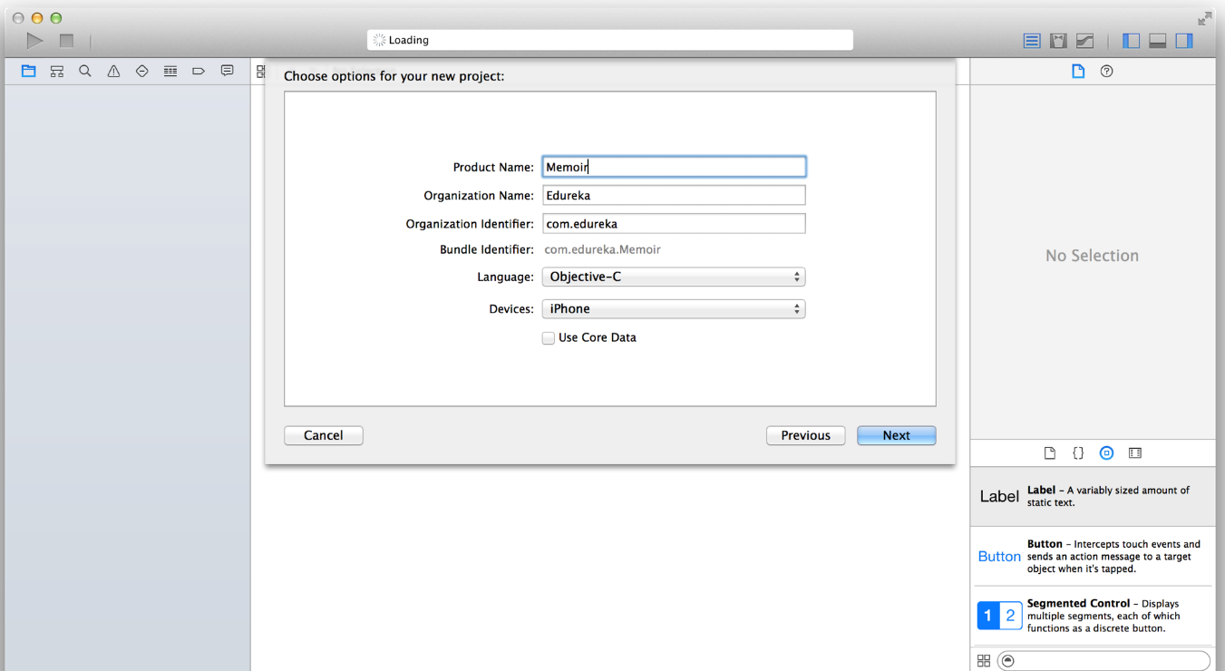

Taking a Picture from Camera
Create a New Project
Step 1: Open Xcode
Step 2: Goto File -> New Project
Enter all the details required like name
Access all the camera controls so that all the options available in that device can be used.
Notes:
Title and Content Slide – Font: Tahoma 12/14 (depending on the amount of text)
Heading: Calibri Heading 26 (consistent)
Bullet code – 174 for bullet
OOBB for sub bullet

Slide 13
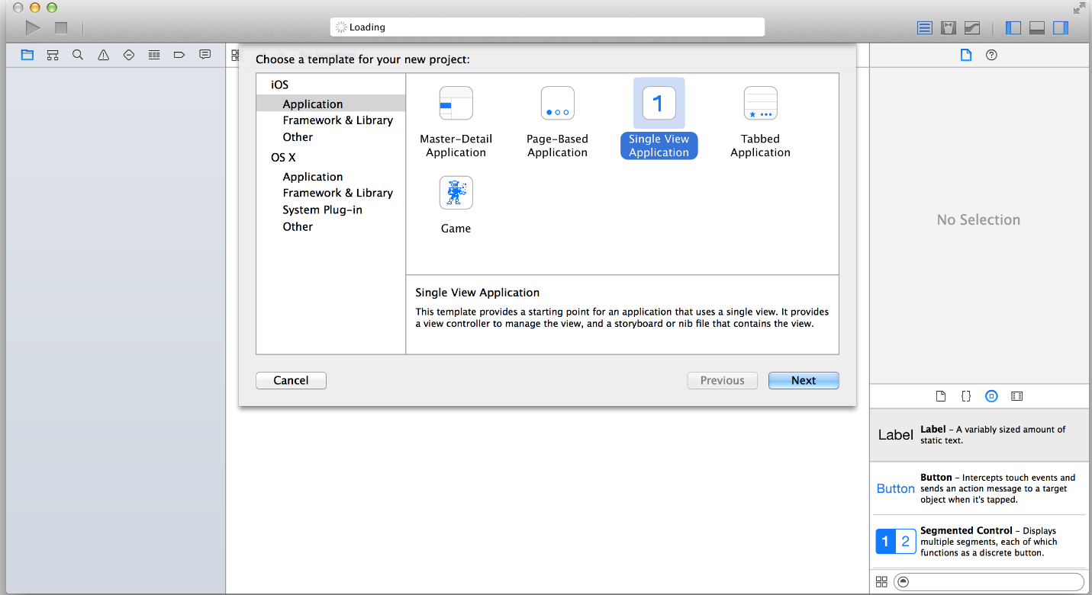
Taking a Picture from Camera (Contd.)
Step 3: Select “Single view application” template
This will create a project with all basic files included
Notes:
Title and Content Slide – Font: Tahoma 12/14 (depending on the amount of text)
Heading: Calibri Heading 26 (consistent)
Bullet code – 174 for bullet
OOBB for sub bullet

Slide 14
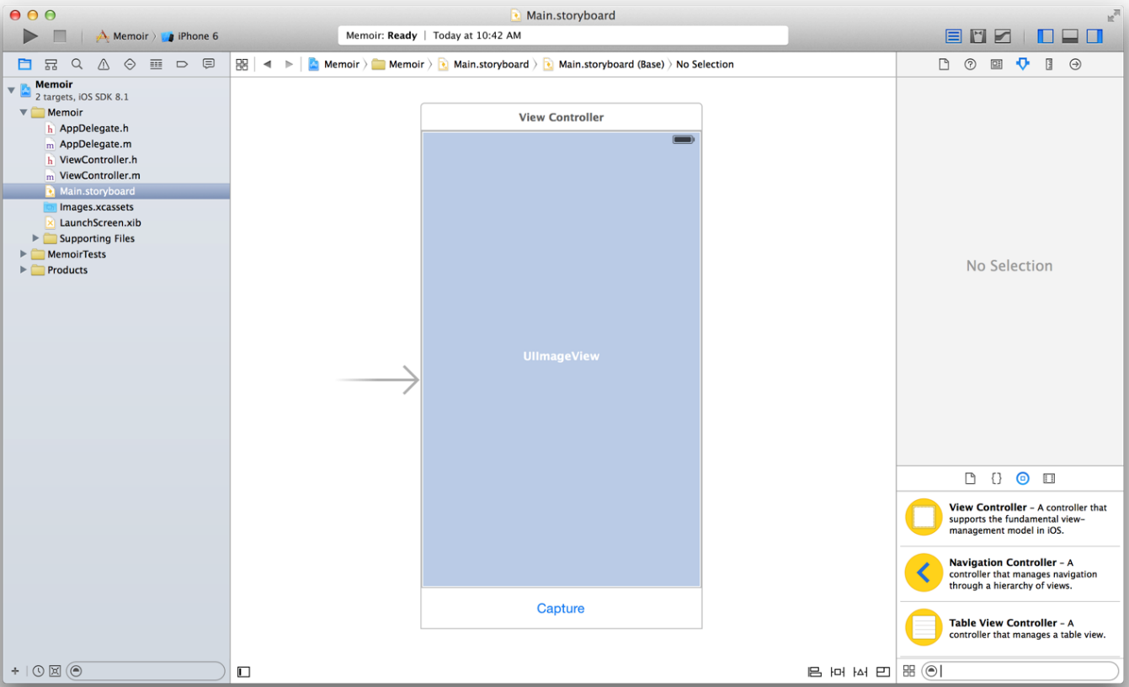
Taking a Picture from Camera (Contd.)
Step 4: Set up your interface by drag and drop objects into your storyboard file
Button – For selecting picture
Image view – For showing the selected image
Notes:
Title and Content Slide – Font: Tahoma 12/14 (depending on the amount of text)
Heading: Calibri Heading 26 (consistent)
Bullet code – 174 for bullet
OOBB for sub bullet

Slide 15
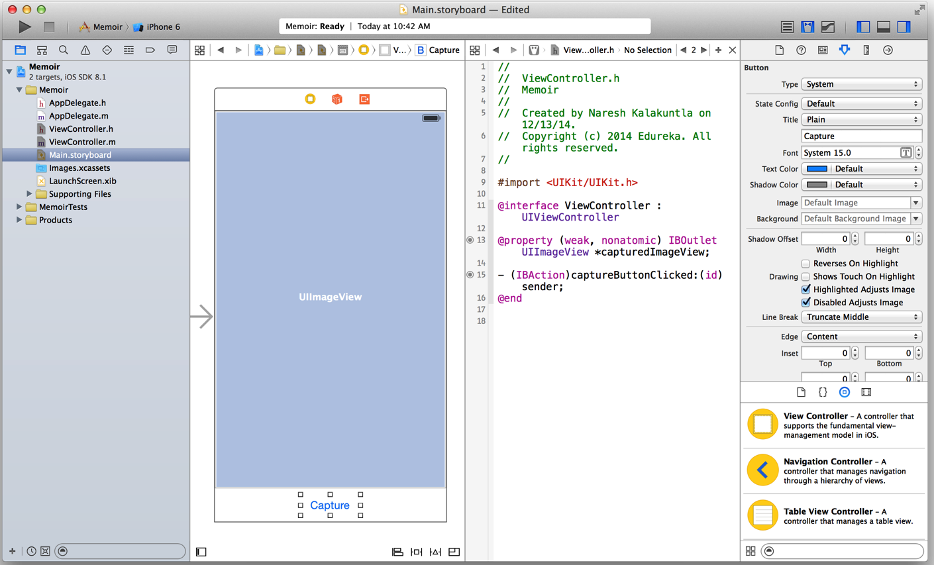
Taking a Picture from Camera (Contd.)
Step 5: Map your UI elements to View Controller by creating properties and actions
Notes:
Title and Content Slide – Font: Tahoma 12/14 (depending on the amount of text)
Heading: Calibri Heading 26 (consistent)
Bullet code – 174 for bullet
OOBB for sub bullet

Slide 16
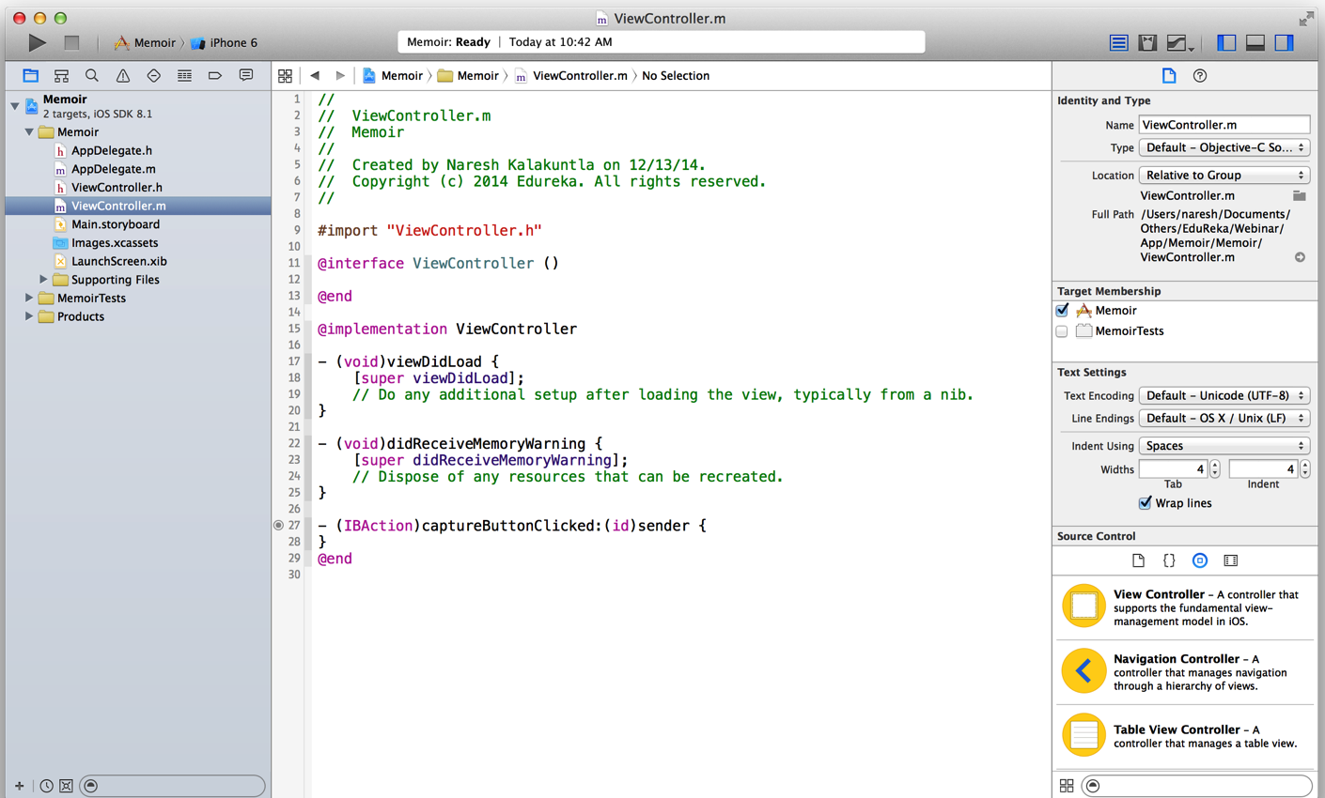
Taking a Picture from Camera (Contd.)
Step 6: A method in “ViewController.m” will be created for button click
Notes:
Title and Content Slide – Font: Tahoma 12/14 (depending on the amount of text)
Heading: Calibri Heading 26 (consistent)
Bullet code – 174 for bullet
OOBB for sub bullet

Slide 17
Taking a Picture from Camera (Contd.)
Step 7: Replace your “captureButtonClicked:” method with below code
- (IBAction)captureButtonClicked:(id)sender {
UIActionSheet *imageSelectionActinSheet =
[[UIActionSheet alloc] initWithTitle:@"Select Image"
delegate:self
cancelButtonTitle:@"Cancel"
destructiveButtonTitle:nil
otherButtonTitles:@"Camera",@"Image Library", nil];
[imageSelectionActinSheet showInView:self.view];
}
Button Selection Methods:
- (void)actionSheet:(UIActionSheet *)actionSheet clickedButtonAtIndex:(NSInteger)buttonIndex {
if (buttonIndex == 0) {
[self selectImageFromCamera];
} else {
[self selectImageFromPhotoLibrary];
}
}
Notes:
Title and Content Slide – Font: Tahoma 12/14 (depending on the amount of text)
Heading: Calibri Heading 26 (consistent)
Bullet code – 174 for bullet
OOBB for sub bullet

Slide 18
Taking a Picture from Camera (Contd.)
Step 8: Configure your buttons for source type selection
For type camera
- (void)selectImageFromCamera {
if ([UIImagePickerController isSourceTypeAvailable:UIImagePickerControllerSourceTypeCamera]) {
UIImagePickerController *picker = [[UIImagePickerController alloc] init];
picker.delegate = self;
picker.sourceType = UIImagePickerControllerSourceTypeCamera;
picker.mediaTypes = @[(NSString *)kUTTypeImage];
picker.allowsEditing = YES;
[self presentViewController:picker animated:YES completion:nil];
} else {
UIAlertView *cameraAlert = [[UIAlertView alloc] initWithTitle:@"Camera Not Available" message:@"Please select any device with camera capability" delegate:self cancelButtonTitle:@"Okay" otherButtonTitles: nil];
[cameraAlert show];
}
}
Notes:
Title and Content Slide – Font: Tahoma 12/14 (depending on the amount of text)
Heading: Calibri Heading 26 (consistent)
Bullet code – 174 for bullet
OOBB for sub bullet

Slide 19
Taking a Picture from Camera (Contd.)
Step 9: Confogure your buttons for source type selection
For type photo library
- (void)selectImageFromPhotoLibrary {
UIImagePickerController *picker = [[UIImagePickerController alloc] init];
picker.delegate = self;
picker.sourceType = UIImagePickerControllerSourceTypePhotoLibrary;
picker.mediaTypes = @[(NSString *)kUTTypeImage];
picker.allowsEditing = YES;
[self presentViewController:picker animated:YES completion:nil];
}
Notes:
Title and Content Slide – Font: Tahoma 12/14 (depending on the amount of text)
Heading: Calibri Heading 26 (consistent)
Bullet code – 174 for bullet
OOBB for sub bullet

Slide 20
Taking a Picture from Camera (Contd.)
Step 10: Listen for image selection methods
- (void)imagePickerController:(UIImagePickerController *)picker
didFinishPickingImage:(UIImage *)image
editingInfo:(NSDictionary *)editingInfo {
if (image) {
self.capturedImageView.image = image;
}
[self dismissViewControllerAnimated:YES completion:nil];
}
- (void)imagePickerControllerDidCancel:(UIImagePickerController *)picker {
[self dismissViewControllerAnimated:YES completion:nil];
}
Notes:
Title and Content Slide – Font: Tahoma 12/14 (depending on the amount of text)
Heading: Calibri Heading 26 (consistent)
Bullet code – 174 for bullet
OOBB for sub bullet

Slide 21




Taking a Picture from Camera (Contd.)
Final UI Flow is as follow
Notes:
Title and Content Slide – Font: Tahoma 12/14 (depending on the amount of text)
Heading: Calibri Heading 26 (consistent)
Bullet code – 174 for bullet
OOBB for sub bullet

Slide 22
Requirement 2 :
Saving the Picture in the Photo Library
Notes:
Title and Content Slide – Font: Tahoma 12/14 (depending on the amount of text)
Heading: Calibri Heading 26 (consistent)
Bullet code – 174 for bullet
OOBB for sub bullet

Slide 23
Saving Pictures
Edit your imagePickerController:didFinishPickingImage:editingInfo: method for saving a picture to photo library
- (void)imagePickerController:(UIImagePickerController *)picker
didFinishPickingImage:(UIImage *)image
editingInfo:(NSDictionary *)editingInfo {
if (image) {
self.capturedImageView.image = image;
if (_newMedia) {
UIImageWriteToSavedPhotosAlbum(image, self, @selector(imageSaved), nil);
}
}
}
[self dismissViewControllerAnimated:YES completion:nil];
}
Notes:
Title and Content Slide – Font: Tahoma 12/14 (depending on the amount of text)
Heading: Calibri Heading 26 (consistent)
Bullet code – 174 for bullet
OOBB for sub bullet

Slide 24
Requirement 3 :
Show all the Locations on Map
Notes:
Title and Content Slide – Font: Tahoma 12/14 (depending on the amount of text)
Heading: Calibri Heading 26 (consistent)
Bullet code – 174 for bullet
OOBB for sub bullet

Slide 25
Showing Picture Locations on Map
We need to save the location of the picture when we save the image
Get the coordinates of present location using CLCocationManager
- (void)getCurrentLocation:(id)sender {
_locationManager.delegate = self;
_locationManager.desiredAccuracy = kCLLocationAccuracyBest;
[_locationManager startUpdatingLocation];
}
This will call a delegate method when location is obtained
- (void)locationManager:(CLLocationManager *)manager
didUpdateToLocation:(CLLocation *)newLocation
fromLocation:(CLLocation *)oldLocation
{
CLLocation *currentLocation = newLocation;
NSLog(@"longitude: %@",[NSString stringWithFormat:@"%.8f", currentLocation.coordinate.longitude]);
NSLog(@"latitude: %@",[NSString stringWithFormat:@"%.8f", currentLocation.coordinate.latitude]);
}
Notes:
Title and Content Slide – Font: Tahoma 12/14 (depending on the amount of text)
Heading: Calibri Heading 26 (consistent)
Bullet code – 174 for bullet
OOBB for sub bullet

Slide 26
Showing Picture Locations on Map (Contd.)
Now we have to show this coordinate on map
Drag and drop MapView in the Storyboard
Create an outlet to your view controller (same as button and imageview)
Add below code to show your location on the app
self.mapView.mapType = MKMapTypeHybrid;
self.mapView.zoomEnabled = NO;
MKCoordinateRegion region;
region.center.latitude = self.mapView.userLocation.coordinate.latitude;
region.center.longitude = self.mapView.userLocation.coordinate.longitude;
[self.mapView setRegion:region animated:YES];
Notes:
Title and Content Slide – Font: Tahoma 12/14 (depending on the amount of text)
Heading: Calibri Heading 26 (consistent)
Bullet code – 174 for bullet
OOBB for sub bullet

Slide 27
Requirement 3 :
Share your Picture on Social Media
Facebook
Notes:
Title and Content Slide – Font: Tahoma 12/14 (depending on the amount of text)
Heading: Calibri Heading 26 (consistent)
Bullet code – 174 for bullet
OOBB for sub bullet

Slide 28
Sharing your Thoughts on Social Networks
We have three types of services inbuilt
SLServiceTypeTwitter;
SLServiceTypeFacebook;
SLServiceTypeSinaWeibo;
Let us use Facebook for now
Create a Facebook controller and completion handler on what to do after posting
SLComposeViewController *fbController=[SLComposeViewController
composeViewControllerForServiceType:SLServiceTypeFacebook];
SLComposeViewControllerCompletionHandler __block completionHandler=^(SLComposeViewControllerResult result){
[fbController dismissViewControllerAnimated:YES completion:nil];
switch(result){
case SLComposeViewControllerResultCancelled:
default:
NSLog(@"Cancelled.....");
break;
case SLComposeViewControllerResultDone:
NSLog(@"Posted....");
break;
}};
Notes:
Title and Content Slide – Font: Tahoma 12/14 (depending on the amount of text)
Heading: Calibri Heading 26 (consistent)
Bullet code – 174 for bullet
OOBB for sub bullet

Slide 29
Sharing your Thoughts on Social Networks (Contd.)
Create a Facebook controller and then post it
[fbController addImage:_capturedImageView.image];
[fbController setInitialText:@"Check out this Image."];
[fbController setCompletionHandler:completionHandler];
[self presentViewController:fbController animated:YES completion:nil];
Notes:
Title and Content Slide – Font: Tahoma 12/14 (depending on the amount of text)
Heading: Calibri Heading 26 (consistent)
Bullet code – 174 for bullet
OOBB for sub bullet

Slide 30

Job Trends
Appstore has more than 850,000 apps and more than 45 billion downloads in less than five years
There are more than $10 iOS customers worldwide
You can reach them with your ideas
291,250 iOS app economy jobs in the U.S are generated
There are 275,000 registered iOS developers in the U.S.
Nearly 6000 iOS developer jobs are available now on job search aggregator Indeed.com (Only in US)
$9 billion paid to Apple developers from App Store sales
Notes:
Title and Content Slide – Font: Tahoma 12/14 (depending on the amount of text)
Heading: Calibri Heading 26 (consistent)
Bullet code – 174 for bullet
OOBB for sub bullet

Slide 31
Course Topics
Module 1
Course Introduction, Overview of iOS, MVC Objective-C
Module 2
Objective C
Module 3
Foundation Framework, Attributed Strings
Module 4
Multiple MVC’s
Module 5
Protocols, Blocks, Animations, Autolayout
Module 6
Multithreading, Scroll View
Module 7
Persistence, Documents & Core Data
Module 8
Core Location & Map Kit
Module 9
Modal Segue, Text Field, Alerts
Module 10
iCloud, Localization, Push Notifications
Module 11
Getting Started with Swift
Module 12
Diving Deep into Swift

Slide 32
How it Works?

